Slide 1
Monopoly & Monopolistic Competition
Monopoly, Welfare & Market Power
Management 405
Prof. Paola Giuliano · UCLA Anderson

Slide 2
Monopoly & Monopolistic Competition · Roadmap
Outline
1
Profit maximization for price searchers
Set MR = MC; markup and the Lerner index
2
Monopoly and welfare impact
How monopoly restricts output and reduces welfare
3
Government and market power
Antitrust, regulation, and market definition
4
Monopolistic competition
Free entry drives long-run profit to zero
Management 405 · Monopoly and Monopolistic Competition
2

Slide 3





Monopoly & Monopolistic Competition · Market Structures
Where We Are — and Where We're Going
WE ARE HERE
Least market power
Most market power
Perfect
Competition
Monopolistic
Competition
Oligopoly
Monopoly
(Price takers)
(Price searchers)
Management 405 · Monopoly and Monopolistic Competition
3

Slide 4

Monopoly & Monopolistic Competition · Market Structures
Market Structure: Monopoly
Number of firms | Single seller
Product differentiation | Very high — no close substitutes
Entry conditions | Restricted access (barriers)
Profit potential | Positive profit in the short and long run
Examples | Microsoft; gas, water & electric utilities; big tech (?)
Management 405 · Monopoly and Monopolistic Competition
4
Notes:
Article on amazon-mgm
https://www.npr.org/2022/03/17/1087268067/amazon-mgm-deal
Article on att-time-warner merger
https://www.cnn.com/2019/02/26/media/att-time-warner-merger-ruling/index.html
In 2018, a merger between AT&T and Time Warner
The federal government on Tuesday lost its second court challenge to AT&T’s $85.4 billion merger with Time Warner, a blockbuster deal that has already begun to reshape much of the media industry.
Justice Department lawyers have argued that the combination of the two companies would reduce competition and hurt consumers.
AT&T can now proceed with its plan to transform WarnerMedia into a streaming-video business in its version of the television industry’s go-to strategy. The company has said it would unveil several online video products by early next year, with the premium cable channel HBO anchoring a service that would feature films and television shows from the Warner Bros. library. (HBO will continue to be available as a stand-alone service.)
That means blockbuster movies like “Wonder Woman” and installments of the Harry Potter franchise could show up on the service next to TV shows like “Friends” and HBO hits like “Game of Thrones.” AT&T also plans to license some of its video properties to services like Netflix, a strategy that could undermine its own streaming product since audiences would be able to watch its shows and movies elsewhere
In the case of AT&T and Time Warner, which has been renamed WarnerMedia, the wireless provider is considered a content distributor and the media business a content supplier. AT&T said that because the companies did not compete, the merger would yield benefits for customers like lower bills and new shows tailored for mobile devices.
The deal brought together one of the nation’s largest wireless providers with a vast media business that includes CNN in addition to HBO and Warner Bros. AT&T has over 153 million wireless subscribers and also owns the satellite TV service DirecTV.
In 2021, After AT&T spent so much time fighting to acquire Time Warner, its decision to let those assets go is an acknowledgment of the new realities of the streaming wars, which seem to reward services with sprawling content offerings like Netflix’s and Disney’s deep archive of beloved classics.
When AT&T’s bold megadeal to buy Time Warner was announced in October 2016, combining AT&T’s broadband and wireless networks with Time Warner content, many analysts and investors cheered. They loved the promise of cutting out the cable middleman and delivering entertainment directly to people’s TVs, laptops and phones.
Less than four years after the merger, AT&T abandoned its grand initiative. It spun off its Warner Media assets and ceded management control to Discovery. The new company, Warner Bros. Discovery, took on $43 billion of AT&T’s debt, and AT&T shareholders kept 71 percent of the company, a stake worth less than $20 billion.
https://www.nytimes.com/2022/11/19/business/media/att-time-warner-deal.html

Slide 5
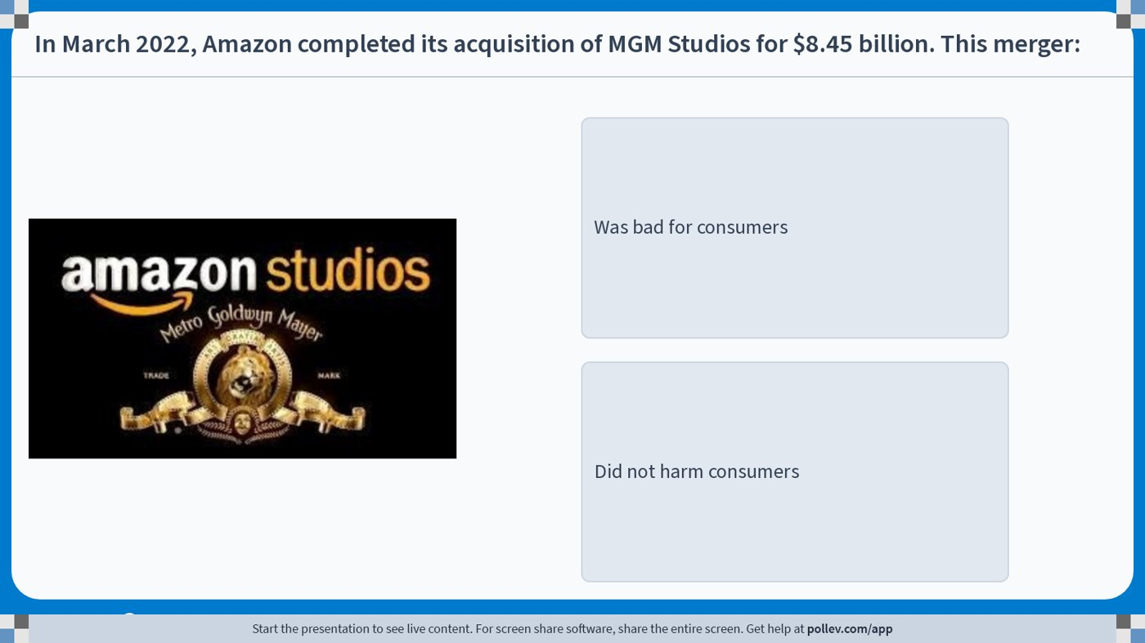
Monopoly & Monopolistic Competition · Monopoly & Welfare
Poll: Was the Amazon–MGM Merger Bad for Consumers?
Management 405 · Monopoly and Monopolistic Competition
5
Notes:
Do not modify the notes in this section to avoid tampering with the Poll Everywhere activity.
More info at polleverywhere.com/support
In March 2022, Amazon completed its acquisition of MGM Studios for $8.45 billion. This merger:
https://www.polleverywhere.com/multiple_choice_polls/IJ8aUfND9oCGPDbgSvELK?display_state=instructions&activity_state=opened&state=opened&flow=Engagement&onscreen=persist

Slide 6
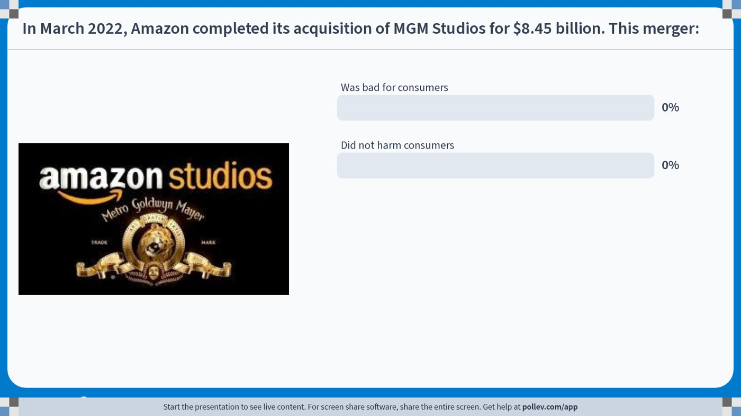
Monopoly & Monopolistic Competition · Monopoly & Welfare
Poll: Live Responses
Management 405 · Monopoly and Monopolistic Competition
6
Notes:
Do not modify the notes in this section to avoid tampering with the Poll Everywhere activity.
More info at polleverywhere.com/support
In March 2022, Amazon completed its acquisition of MGM Studios for $8.45 billion. This merger:
https://www.polleverywhere.com/multiple_choice_polls/IJ8aUfND9oCGPDbgSvELK?display_state=chart&activity_state=opened&state=opened&flow=Engagement&onscreen=persist

Slide 7
Monopoly & Monopolistic Competition · Monopoly & Welfare
Poll: Results
Management 405 · Monopoly and Monopolistic Competition
7
Notes:
Do not modify the notes in this section to avoid tampering with the Poll Everywhere activity.
More info at polleverywhere.com/support
In March 2022, Amazon completed its acquisition of MGM Studios for $8.45 billion. This merger:
https://www.polleverywhere.com/multiple_choice_polls/IJ8aUfND9oCGPDbgSvELK?display_state=chart&activity_state=closed&state=closed&flow=Engagement&onscreen=persist

Slide 8
Monopoly & Monopolistic Competition · Monopoly & Welfare
Monopoly: Good for Business, Bad for Welfare
Price
Problem Set 4 · #2
P_{max}
Consumer surplus under monopoly
Producer surplus under monopoly
Deadweight loss under monopoly
P_{M}
MC
P_{C}
D
MR
Q_{M}
Q_{C}
Q
Management 405 · Monopoly and Monopolistic Competition
8
Notes:
Since a monopolist charges a price above the MC, you might suspect that having market power is beneficial for firms. It is! We can characterize the welfare consequences of market power and specify how it affects consumers and the firm.
We compute consumer and producer surplus similar to the competitive market setting.
Consumer surplus: the area under the demand curve and above the price
Producer surplus: the area above the MC curve and below the price. (Recall that a firm’s short run supply curve in a perfectly competitive market is where the MC curve is above AVC.)
Under monopoly (relative to perfect competition):
--consumer surplus declines.
--producer surplus rises.
--total welfare is reduced (deadweight loss of market power).

Slide 9
Monopoly & Monopolistic Competition · Monopoly & Welfare
Monopoly: Take-aways
A monopolist restricts quantity to raise price
  Higher profits for the firm
  Smaller consumer surplus
  Lower total welfare — a deadweight loss
Management 405 · Monopoly and Monopolistic Competition
9

Slide 10

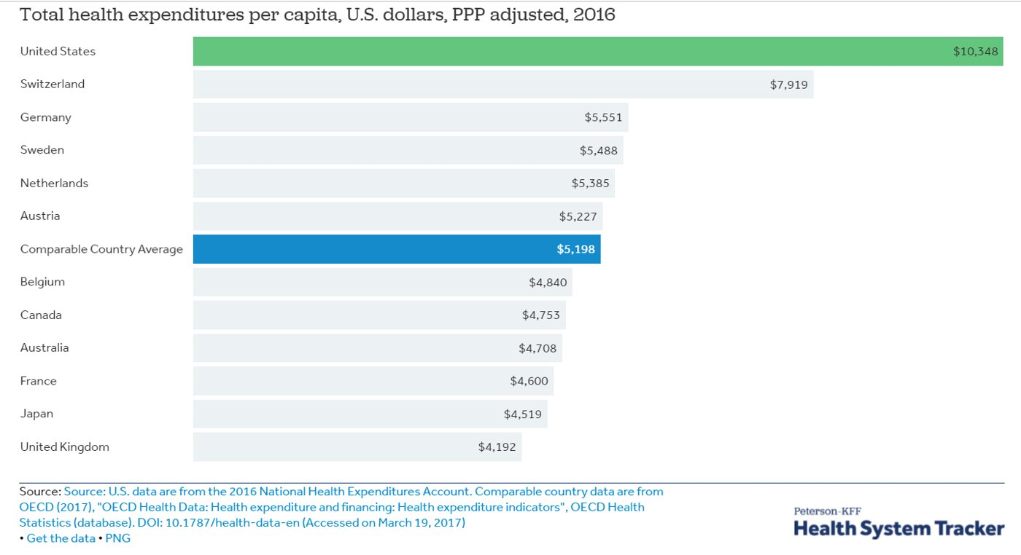
Monopoly & Monopolistic Competition · Monopoly & Welfare
Concentration in Health Care
Source: concentrationcrisis.openmarketsinstitute.org
Management 405 · Monopoly and Monopolistic Competition
10
Notes:
This website is really cool: https://concentrationcrisis.openmarketsinstitute.org/
You can click on the sector and see how concentrated each market is:

Slide 11

Monopoly & Monopolistic Competition · Monopoly & Welfare
Ultra-Low-Cost Carriers Discipline Prices
Ultra-low-cost carriers (ULCCs) enter routes aggressively
When a ULCC starts flying a route:
  Fares fall sharply — Chicago 23%, Newark 22%, Houston 21%, Dallas 20%, Las Vegas 20%
  Passenger numbers rise
Management 405 · Monopoly and Monopolistic Competition
11
Notes:
ULCC: discussion on page 321 of the textbook
Allegiant, Frontier and Spirit, undercut fares offered by incumbent carriers.
Prices can fall by double digit, number of passengers goes up.
Drop in prices: Chicago O’Hare (23%), Newark (22%), Houston George Bush Intercontinental (21%), Dallas/Fort Worth (20%), Las Vegas McCarran (20%)
The airline sector is very concentrated: Delta (22%), American (21%), United (18%), Southwest (15%)

Slide 12
Monopoly & Monopolistic Competition · Roadmap
Outline
1
Profit maximization for price searchers
Set MR = MC; markup and the Lerner index
2
Monopoly and welfare impact
How monopoly restricts output and reduces welfare
3
Government and market power
Antitrust, regulation, and market definition
4
Monopolistic competition
Free entry drives long-run profit to zero
Management 405 · Monopoly and Monopolistic Competition
12

Slide 13
Monopoly & Monopolistic Competition · Government & Market Power
Governments and Market Power
Price regulations
  Happens frequently with natural monopolies: electricity, natural gas, cable television, local telephone service
  Impose a price cap → increase consumer surplus, reduce producer surplus, increase quantity
Antitrust laws
  Prevent mergers/acquisitions that would limit competition
  Occasionally force breakup of existing firm (AT&T in 1982)
  Ban collusion on prices
Patents, licenses and copyrights
  Encourage monopolies for the sake of innovation
  Consumer surplus from product creation outweighs DWL
  Lead to innovation in types of goods that people value, but high prices
Management 405 · Monopoly and Monopolistic Competition
13
Notes:
Two rationales for regulating monopoly:
-- total welfare
-- allocation of surplus among consumers and producers
AT&T long distance service, Bell local services
For more on the AT&T breakup: http://articles.latimes.com/1995-09-21/business/fi-48462_1_system-breakup

Slide 14
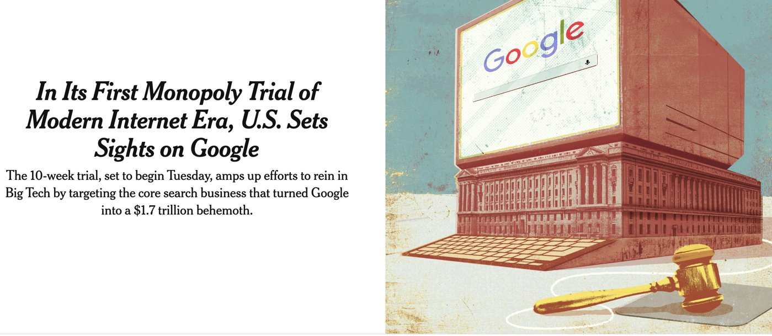
Monopoly & Monopolistic Competition · Government & Market Power
Antitrust: The Google Trial
What were the main outcomes of Judge Mehta's ruling for Google?
What new requirement did he impose regarding Google's data?
What type of remedy did Judge Mehta emphasize?
How has the rise of AI shaped his decision?
Class discussion break
Management 405 · Monopoly and Monopolistic Competition
14
Notes:
What are the main outcomes of Judge Mehta’s ruling for Google?
Barred from making exclusive search deals
Allowed to keep Chrome (no divestiture)
Allowed to keep its agreement with Apple (with oversight)
2. What new requirement did the judge impose on Google regarding its data?
Google must share its search index and click/interaction data with competitors to help them build rival search engines.
3. What type of remedy did Judge Mehta emphasize?
He emphasized behavioral remedies (rules about how Google can act in the future) rather than structural remedies (like breaking up the company).
4. How has the rise of AI influenced Judge Mehta’s decision in the Google case?
The growth of AI tools and chatbots was seen as creating new competition for search. This likely influenced Mehta’s choice not to impose drastic structural changes, since the market may already be shifting due to technological innovation.

Slide 15
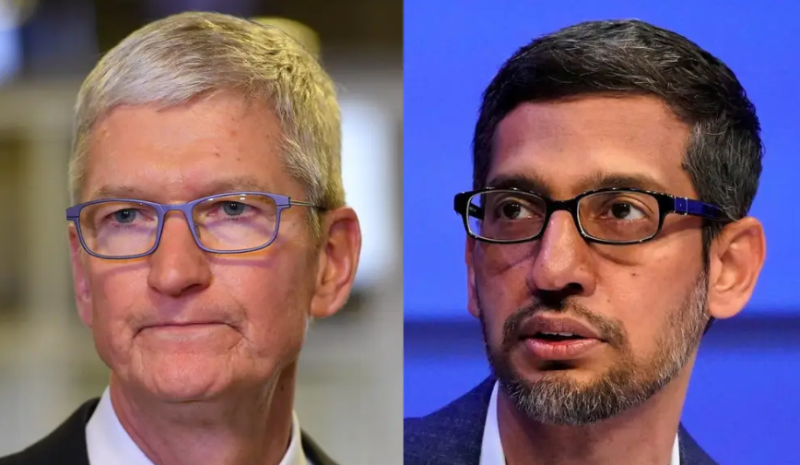
Monopoly & Monopolistic Competition · Government & Market Power
The Google–Apple Search Deal
“Google paid Apple up to $12 billion for a search-engine deal that disadvantaged competitors,” a landmark antitrust suit claims.
▶ WSJ Explains: How Apple & Google formed one of tech's most powerful partnerships
Tim Cook (Apple) · Sundar Pichai (Google)
Management 405 · Monopoly and Monopolistic Competition
15
Notes:
Video in the article is very good

Slide 16
Monopoly & Monopolistic Competition · Government & Market Power
The Google Antitrust Case: A Timeline
Oct 2020
DOJ and 11 states sue Google for illegally monopolizing online search
UNITED STATES v. GOOGLE LLC
2023
10-week bench trial before Judge Amit Mehta (Washington, D.C.)
Google
Aug 2024
Mehta rules “Google is a monopolist” in search and text ads
Nov 2024
DOJ proposes remedies — including forcing Google to sell Chrome
Sep 2025
Remedies ruling: no breakup; ends exclusive default deals; must share search data
Search-monopoly antitrust trial
U.S. District Court, D.D.C.
Dec 2025
Final judgment entered; Google expected to appeal
Judge Amit P. Mehta · 2020–2025
~90% of U.S. search ~$26B/yr in default deals Behavioral remedy — no breakup
Management 405 · Monopoly and Monopolistic Competition
16

